Slide 1
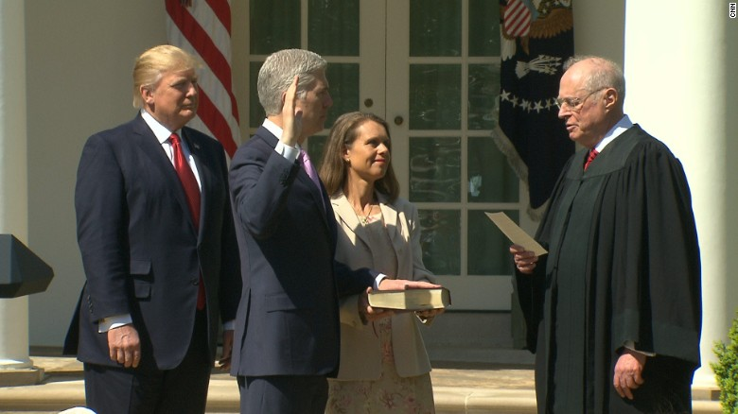
Trumpifying the Judiciary:
Packing the Federal Courts with Conservatives
Artemus Ward
Northern Illinois University
aeward@niu.edu

Slide 2
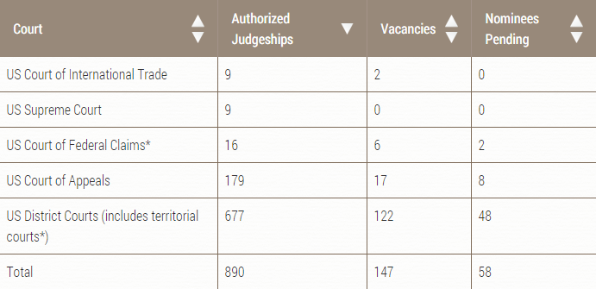
Federal Judicial Vacancies
According to the Constitution, the president formally nominates potential judges.
Yet it is actually the Senators who choose the nominees because all federal district courts are contained within individual states while the courts of appeals are regional covering multiple states.

Slide 3
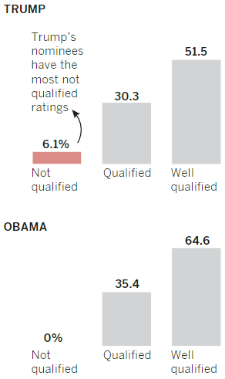
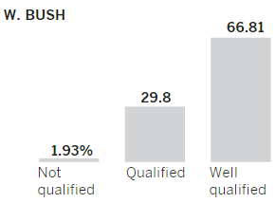
Trumpifying the Judiciary
In the final two years of Obama’s presidency, Senate Republicans engaged in tenacious obstruction to leave as many judicial vacancies unfilled as possible. Also, conservative federal judges waited to time their “retirements” for a GOP president.
In addition to the still-defunct filibuster for lower-court nominees, in Nov. 2017, breaking a 100-year-old tradition, the Senate GOP eliminated the “blue slip” rule that allowed home-state senators to object to (and therefore block) particularly problematic nominees.
The rush to Trumpify the judiciary includes nominees rated unqualified by the American Bar Association, nominees with extreme conservative views, nominees more white and male than have been selected in nearly 40 years, and nominees significantly younger (and, therefore, likely to serve longer) than those of previous presidents.

Slide 4
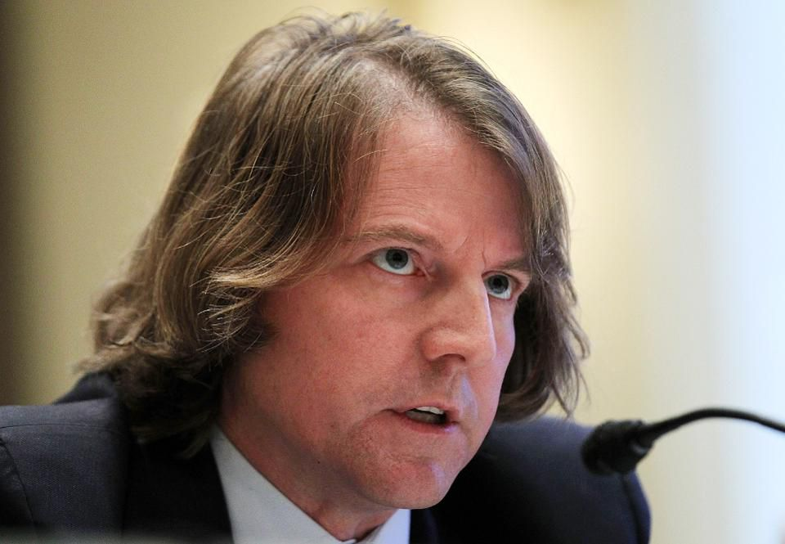
The Selection Process
Trump’s own participation in the selection process varies based on the court.
For the Supreme Court opening, Trump personally interviewed four candidates, making his final decision after meeting each of them once.
For circuit and district judges, the President signs off on the final decision after the interview and vetting process is complete.
But Trump and his team are in sync on what they want in a nominee: judges who are originalists and textualists, meaning they interpret laws based on what they say is the original intent of the Constitution’s framers and based purely on the text, without considering shifting social values or paying much heed to legislative history.
They also want judges who worry about regulations and what they see as the increasing power of unelected bureaucrats, a phenomenon White House Counsel Don McGahn (above), who is in charge of judicial nominees, calls the administrative state.

Slide 5
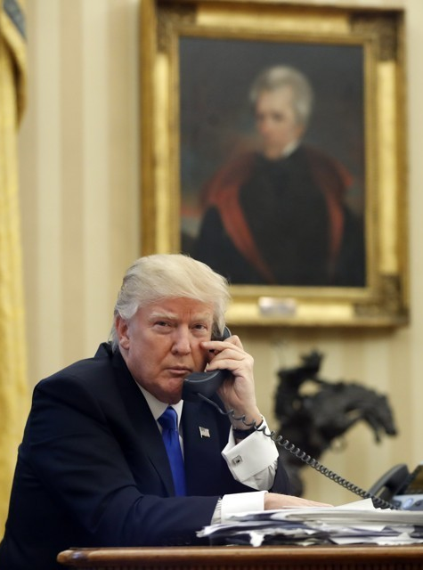
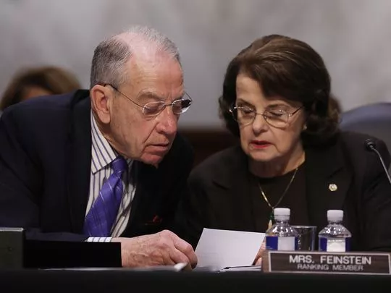
Trump Appointing Judges at Rapid Pace
Despite the large number of vacancies, one year into his presidency, Donald Trump is among the most successful presidents when it comes to appointing federal judges.
Trump has spent his first year rapidly filling judgeships at Supreme, appellate and District Court levels.
Trump is ranked No. 6 of 19 presidents appointing the highest number of federal judges in their first year.
“We’re filling up the courts with really talented people who understand and read the Constitution for what it says,” Trump said. “It’s already having a tremendous impact. These appointments are going to be one of the most important things, if not the most important thing, we do.”

Slide 6
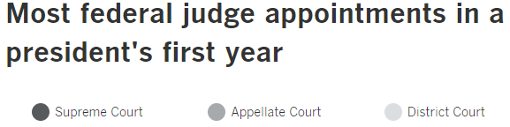
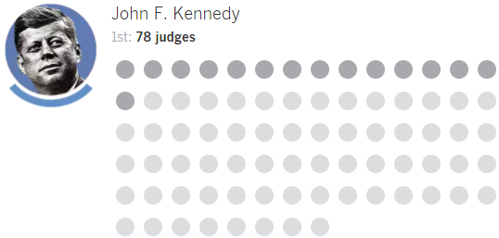
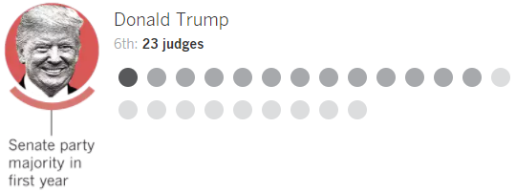







Slide 7
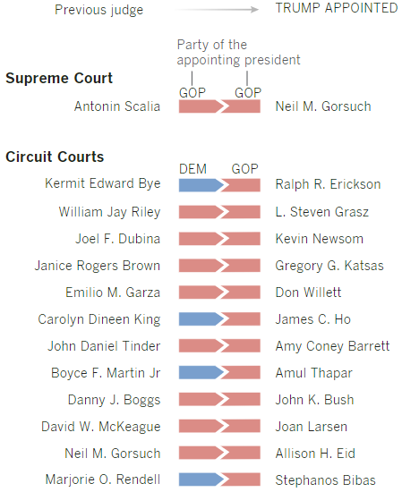
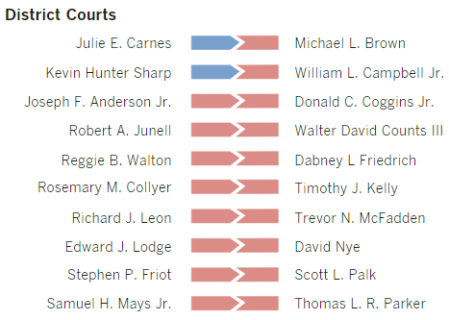
Trump appointed 23 federal judges as of Jan. 17. Most of them replaced judges appointed by a Republican president; six replaced judges appointed by a Democrat.
Four of the appointments to the appellate courts replaced appointees by Democratic presidents – two from Jimmy Carter and two from Bill Clinton. Two of the appointments to the District Courts replaced Obama appointees.

Slide 8
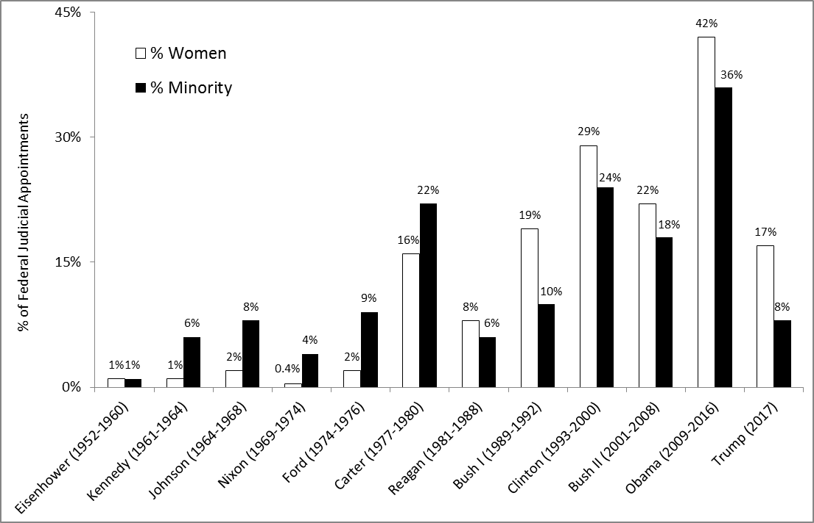
While there was generally an upward trend in women and minority appointments through the Obama administration, Democrats have always appointed more than their predecessors and successors.
However, Trump’s numbers are the lowest in nearly 40 years.
Why?

Slide 9

Court Packing Plan
Conservatives are quietly engaged in court-packing plan where Trump will add twice as many lifetime members to the federal judiciary in two years (650) as President Obama named in eight years (325).
There is a GOP plan in the works to increase the number of federal judgeships by 30-50%.
In addition, the plan calls for Congress to abolish 158 administrative law judgeships in federal regulatory agencies, such as the Environmental Protection Agency, Food and Drug Administration, Federal Communications Commission, and Securities and Exchange Commission, and replace these impartial fact-finders with a new corps of 158 Trump-selected judges who — unlike current administrative law judges — would serve for life.
Unlike the existing administrative law judges, selected as nonpartisan members of the civil service, this new replacement corps would all be picked in a single year, by a single man: Donald J. Trump.
As a result, if this plan passes this year, by sometime in 2018, 1 in 8 cases filed in federal court will be heard by a judge picked by Trump. Many of these judges will likely still be serving in 2050.

Slide 10
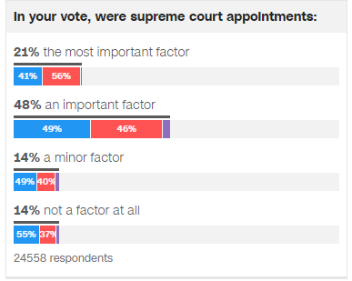
2016 Exit Poll
Supreme Court Matters More to GOP Voters
2016 exit poll showed that nearly 3 out of 4 voters said Supreme Court appointments were an important factor in their vote.
In addition, 21% (most of those Republicans) said it was the most important factor.
Why were Republicans more energized by this issue than Democrats?

Slide 11
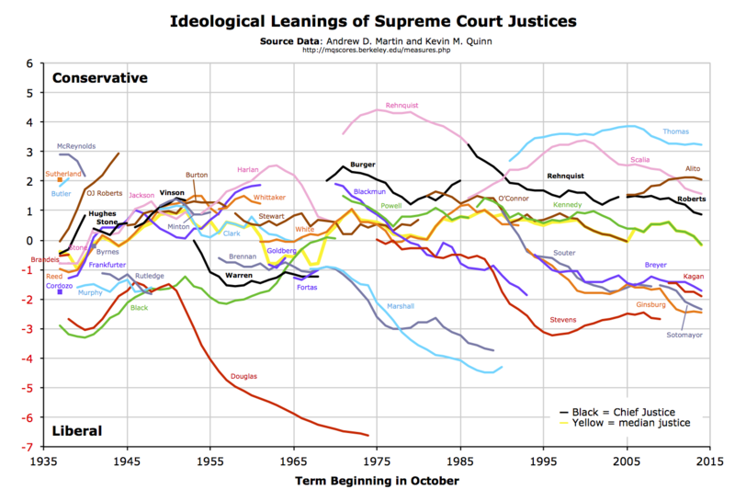

Slide 12
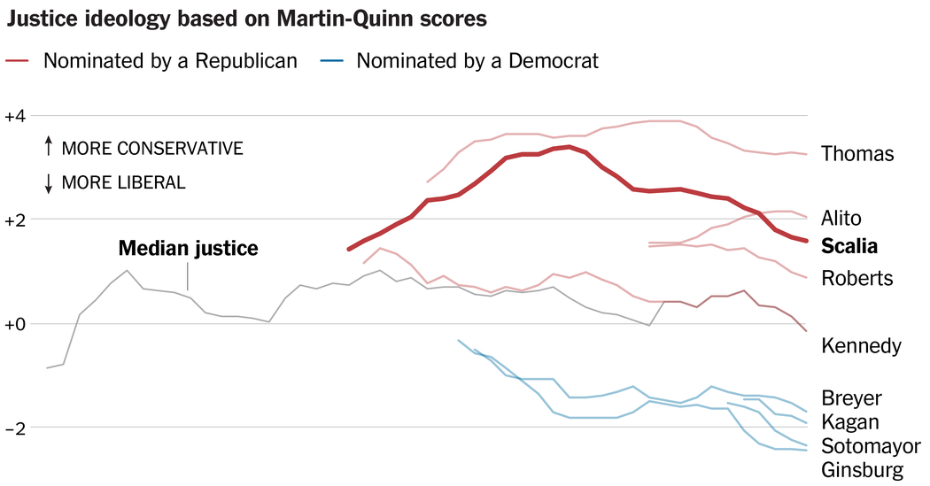

Slide 13
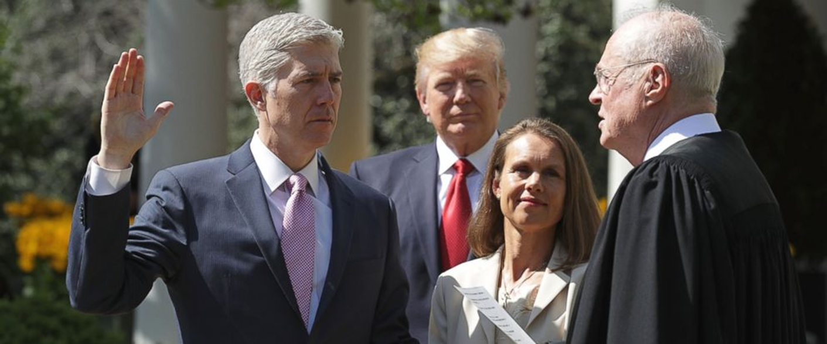
Supreme Court Justice Neil Gorsuch
Trump’s election kept conservative Antonin Scalia’s vacant seat away from the Democrats.
Trump’s nominee, appeals court Judge Neil Gorsuch was the most conservative justice in half a century.
Yet Democrats and liberal interest groups chose not to mount a serious challenge to Gorsuch. Why?
Gorsuch was confirmed by the GOP-controlled Senate 54-45.

Slide 14
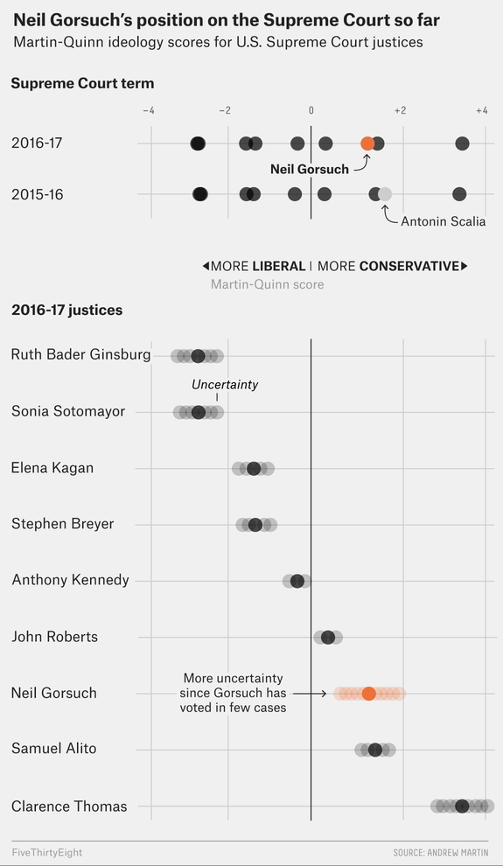
So far, Gorsuch has sided with Thomas in every case.
However, because he has decided so few non-unanimous cases, it is too soon to say how conservative he will be.
Based on his lower-court voting record, he will likely be more conservative than Thomas.

Slide 15
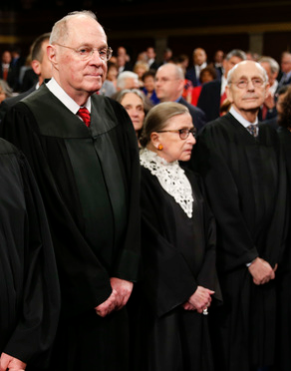
Future Retirements?
Liberals:
Ruth Bader Ginsburg – Born: March 15, 1933 (nearly age 85)
Stephen Breyer – Born: August 15, 1938 (will be age 80)
Conservatives:
Anthony Kennedy – Born: July 23, 1936 (will be age 82)
Average age at death for Supreme Court Justices: 90
Justice John Paul Stevens retired in 2010 at age 90. He will be age 98 in April.
What are the chances that any of these justices will retire in the next few years?
On Feb. 23, 2017, Sen. Ted Cruz (R-TX), a former Supreme Court law clerk, said that he expected a retirement “if not this summer, next summer.” The next day, Ginsburg said: “I will do this job as long as I can do it full steam. When I can't, that will be the time I will step down.” Noting that Stevens departed at 90, she added: “So I have a way to go.”
In the end, it was Kennedy insiders who said he was contemplating retirement.

Slide 16
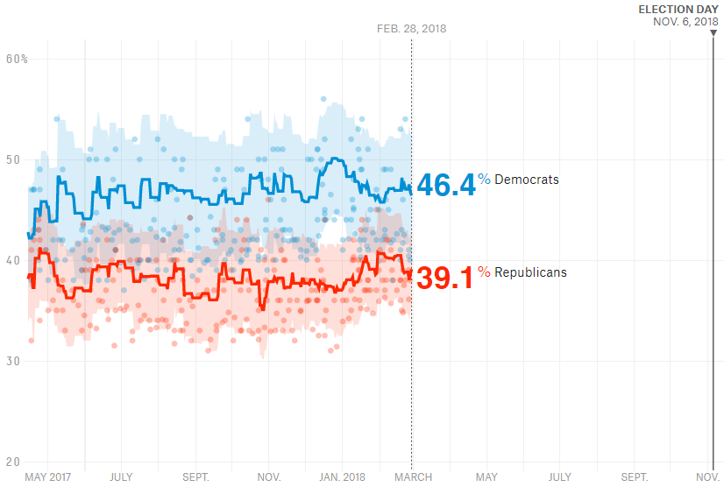
2018 Midterm Election and Senate Control
Currently, the GOP narrowly controls the Senate 51-49.
Only 1/3 of the Senate's 100 seats are up for election in 2018.
The polls show that Americans currently prefer a Democratic-controlled congress.
Should the Democrats win control of the Senate, the President’s pace of judicial appointments will likely slow as he will be forced to nominate moderates if he wants to win confirmation.

Slide 17
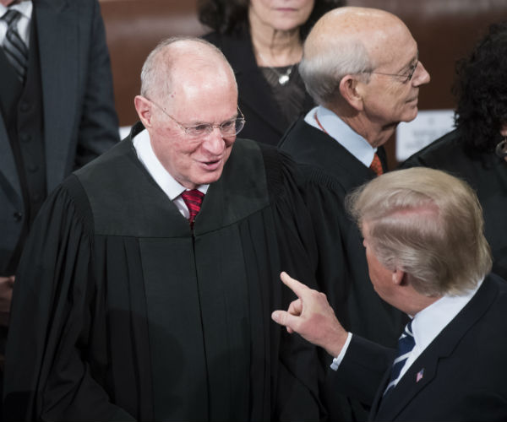
Conclusion
Trump has been very successful in packing the federal
judiciary with conservative judges.
To what extent will the GOP be able to continue to pack the courts in 2018 given that they may lose control of the Senate beginning in 2019?
The latest slate of 9 nominees provides some clues. The White House worked with home-state Senators on 3 conservative, highly qualified appeals court nominees securing strong support from the Democratic Senators in Illinois and Hawaii. Five of the 9 are expected to win quick confirmation.
Should Justice Kennedy retire now or wait until after the 2018 midterm election – or even the 2020 presidential election?

